Slide 1
Brent-Dekker method

Slide 2
Introduction
In this topic, we will
Discuss the weaknesses of previous methods
Consider an algorithm by Dekker, later modified by Brent
We use three bracketed techniques, but ensure a faster convergence

Slide 3
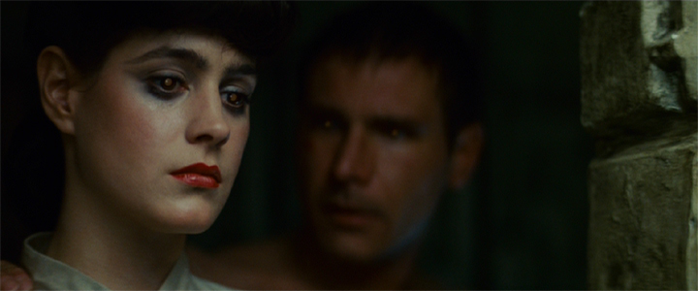
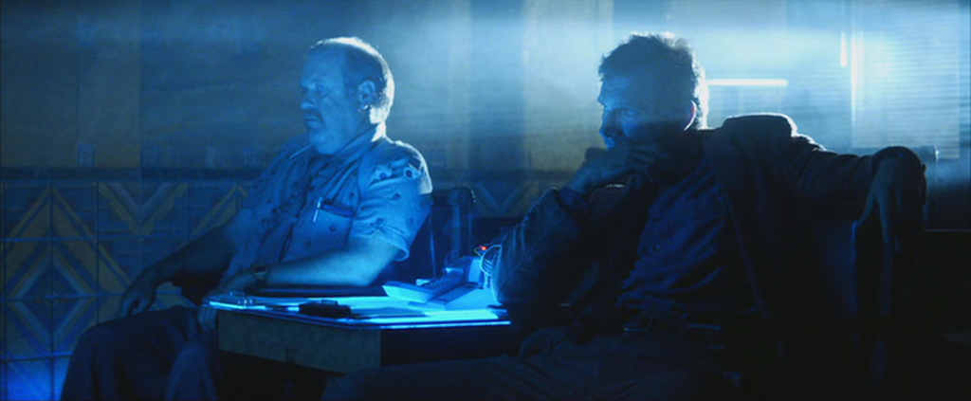
Brent-Dekker method
Unfortunately, this is not the Bryant-Deckard method
Warner Bros.

Slide 4
The Brent-Dekker method
The bisection method only halves the interval size
The bracketed secant method gives a better choice approximating the root
The algorithm, however, generally fixes one end point, and thus is reduced to linear convergence

Slide 5
The Brent-Dekker method
Dekker’s method suggests combining the bisection and bracketed secant methods
Simply alternating these two algorithms significantly increases the convergence of the bracketed secant method
Once a function near the root is either concave up or concave down, one end-point of the secant method becomes fixed
Inserting the bisection method unfixes this end point

Slide 6
The Brent-Dekker method
Brent, in the 1973 text
“Algorithms for minimization without derivatives”
details an algorithm that alternates between
The bisection method
The bracketed secant method
Inverse parabolic interpolation
This results in super-linear convergence
A number of conditions are used:
Ideally, inverse parabolic interpolation is selected, but this technique may be determined to be sub-optimal
It tries to fall back on the bracketed secant method, but this, too, may be sub-optimal
In this case, it reverts to the bisection method

Slide 7
The Brent-Dekker method
Brent’s text is available on his website as a pdf
You are welcome to search for and download this text for your own personal reading
The end of Chapter 4 has an implementation of this algorithm in the algol 60 programming language
You are welcome to translate this into C++ or a language of your choice
This is the first algorithm in this course that has been written in the last half-century
Within the lifetime of your grandparents if not parents
We will see two more algorithms that fall within this time span

Slide 8
The Brent-Dekker method
The Brent-Dekker method is the basis in Matlab for fzero
https://www.mathworks.com/help/matlab/ref/fzero.html
You can view the source code by searching for the file fzero.m

Slide 9
Summary
Following this topic, you now
Are aware of the Brent-Dekker method
Understand that algorithms like this exist and are available
Are aware that the text is available for reference

Slide 10
References
[1] Richard P. Brent, “Algorithms for minimization without derivatives”, Prentice-Hall, 1973

Slide 11
Acknowledgments
None so far.

Slide 12
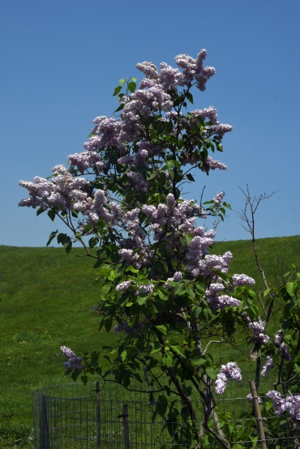
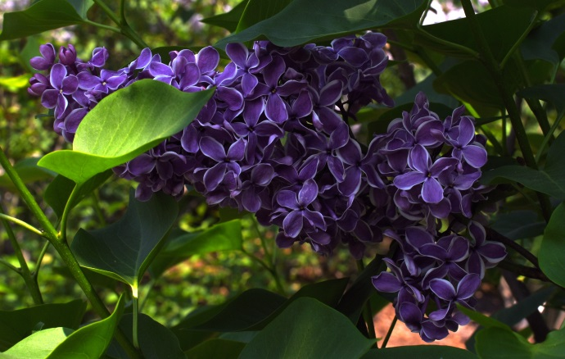
Colophon
These slides were prepared using the Cambria typeface. Mathematical equations use Times New Roman, and source code is presented using Consolas. Mathematical equations are prepared in MathType by Design Science, Inc.
Examples may be formulated and checked using Maple by Maplesoft, Inc.
The photographs of flowers and a monarch butter appearing on the title slide and accenting the top of each other slide were taken at the Royal Botanical Gardens in October of 2017 by Douglas Wilhelm Harder. Please see
https://www.rbg.ca/
for more information.

Slide 13
Disclaimer
These slides are provided for the ece 204 Numerical methods course taught at the University of Waterloo. The material in it reflects the author’s best judgment in light of the information available to them at the time of preparation. Any reliance on these course slides by any party for any other purpose are the responsibility of such parties. The authors accept no responsibility for damages, if any, suffered by any party as a result of decisions made or actions based on these course slides for any other purpose than that for which it was intended.

